Slide 1
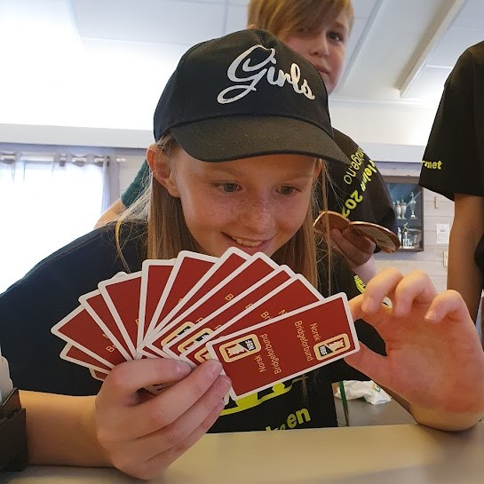


Bridge for kids
A tool for inclusiveness
Notes:
I totally understand if you think the title of my talk is a bit dull. But I believe, that changing our perspective to bridge mainly being an inclusive activity is the key factor to succeeding in creating active bridge groups for kids, and to gain access to the school system.

Slide 2
Talk about
THE PROJECT: Bridge to 10 000 6th graders
How a change of perspective helps to
  get funding
  access schools
  motivate the kids to take part in bridge as an after-school activity
  engage parents
The importance of including every child, no matter what their motivation to play bridge is
Notes:
Today I would like to talk about THE PROJECT (in capital letters) which is that we will give a bridge introduction to 10 000 6th graders within 3 years. The link to «inclusiveness» is that this was enabled by our change of perspective, from «what can new members offer the bridge club», to «what can bridge offer individuals and society».
The other day, a mum came up to me, expressing her gratitude for the bridge group. Her son has special needs, and in many areas he’s not included, and cannot compete with others. She sees that bridge may be a activity that will help him getting friends during a lifetime. We will also see in which ways this change of perspective helps us get funding, gain access to schools, how it’s easier to motivate the kids, and how parents embrace us.
And I will explain why I strongly believe that to include every child, no matter why they joined bridge, is THE key factor to success, and why we, to maintain bridge as a sustainable an after-shool activity for kids, can not let it be an exclusive club for those kids who has the potential to become bridge stars. Because if it is, we will fail in the long run.

Slide 3
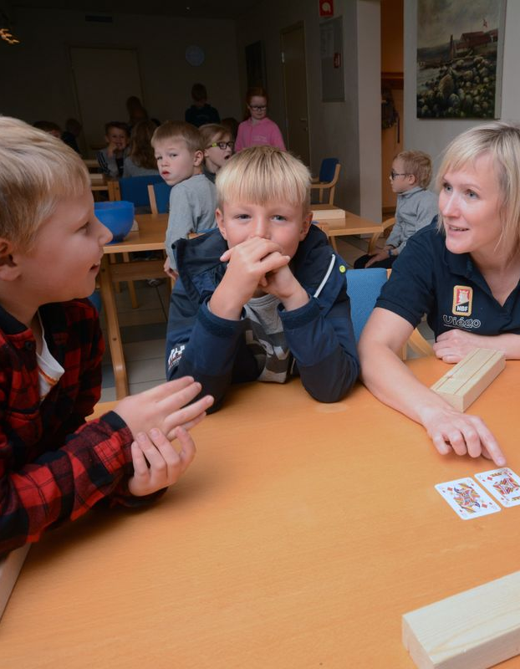
Who am I?
Marianne Harding (46). Project leader of Bridge in schools Norway
Molecular biologist, employed by the Norwegian Bridge-federation since 2009. Teaching and recruiting players.
Have been developing online bridge courses since 2017.
International player since age 19
Mother and daughter of bridge players
Founded Båro Bridgeclub in 2021
Notes:
Currently I’m the project leader of Bridge in schools Norway. Originally I’m a molecular biologist, but I said good bye to genes and cellular biology as soon as I got a chance to put all my money on one horse: Bridge.
I come from a bridge familiy. My grandparents, parents and now my kids all play bridge, and it’s of immensly value to us that we share a common interest. As a child, I used to run sit for hours with my grandmother, playing all kinds of games. And as an adult, I talk to my father every week when he calls with a hand from last night in the club, and I know all my daughters friends really well since they’re all a part of the bridge group.
I think my greatest achievement in bridge is founding the inter-generational Båro Bridgeclub in 2021.

Slide 4
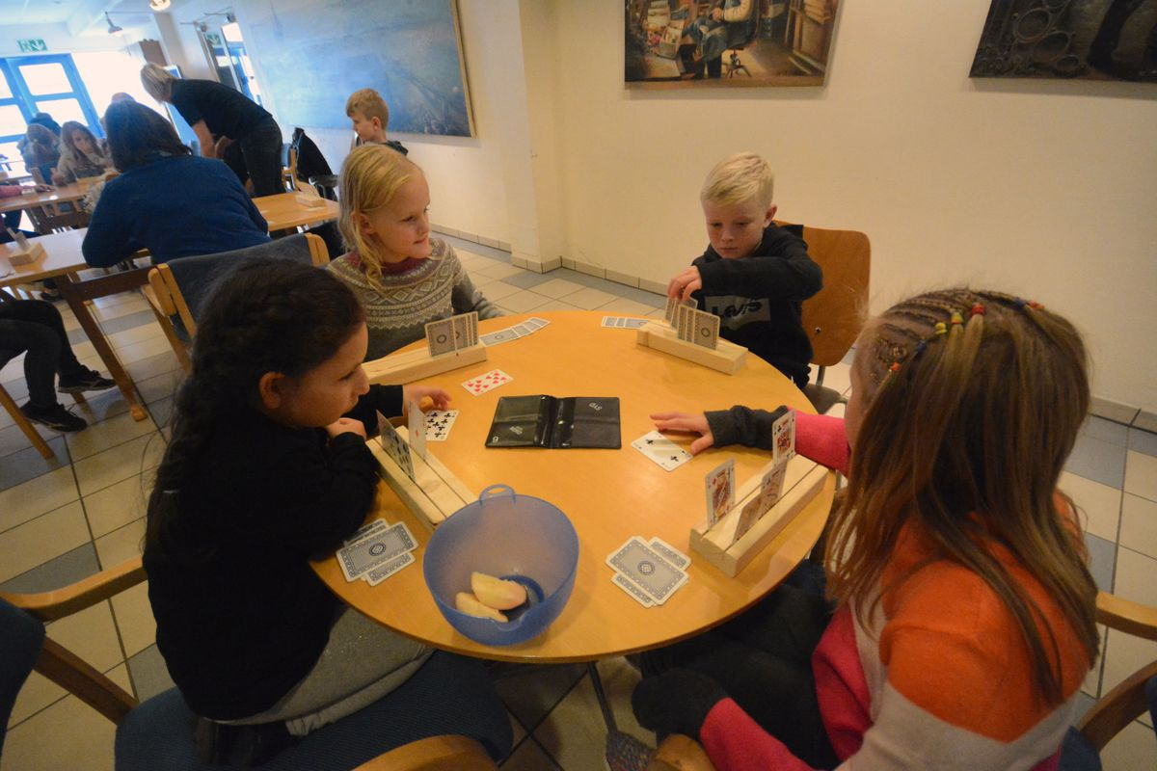
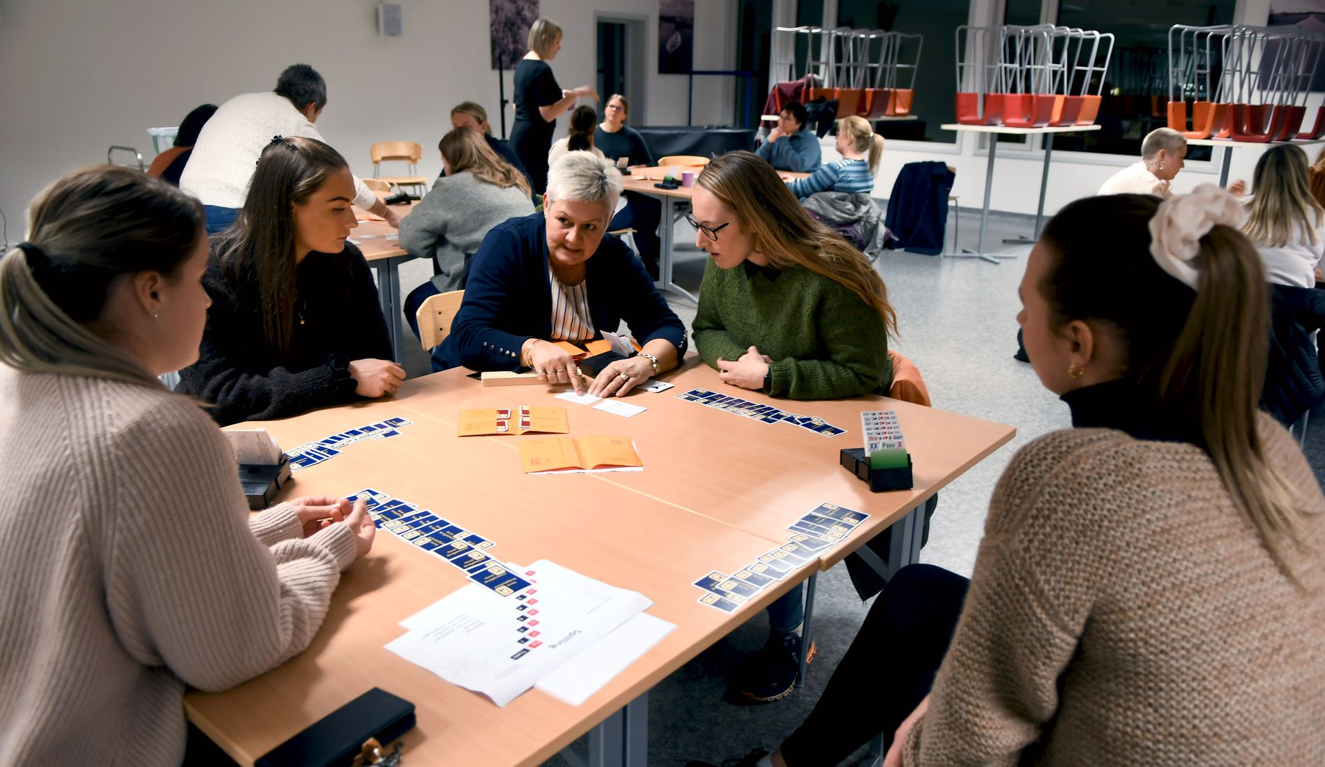
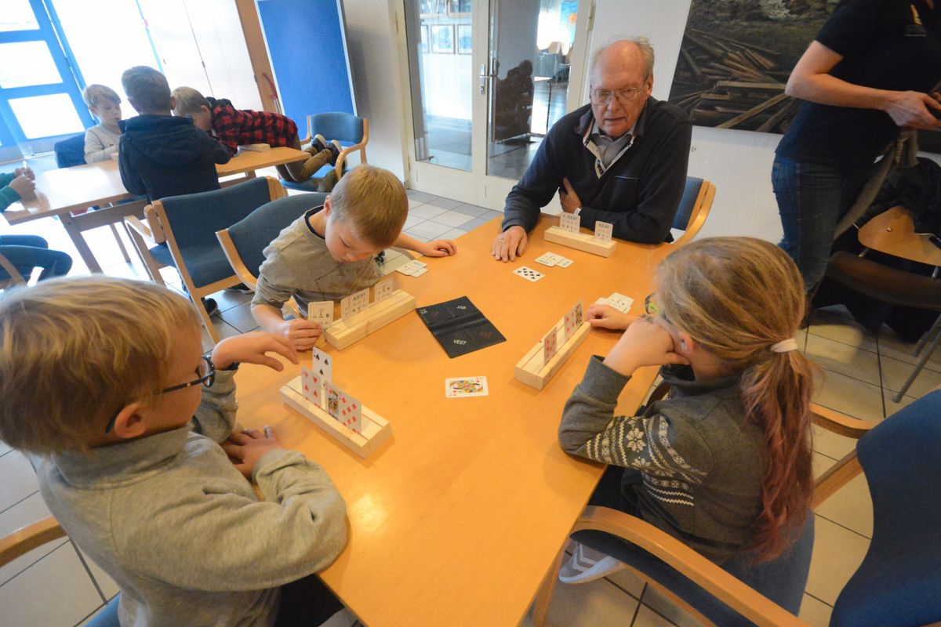
Båro Bridgeclub
Notes:
My background: From teaching mostly adults, in 2018 I founded a bridge group for kids. This was a private initiative, but it turned out so well that we have made this the model for the Bridge in Schools project in Norway. I’ll save the details for another time and jump to conclusions.
Our experiences were:
- Kids love to play cards, but have absolutely no experience in trick taking games.
- Age: Even though some kids may learn bridge from a very young age, as a group, age 10-12 is the ideal age to learn bridge
- At the end of the school day they’re tired and hungry, and to get their autention, we need to feed
- What actually surprised us, was the parents, who love the fact that their kids join the bridge group, and would like to learn bridge themselves
- In 2021 we founded a local bridgeclub in my small village (only 1100 inhabitants) – now 70 members, all beginners.

Slide 5
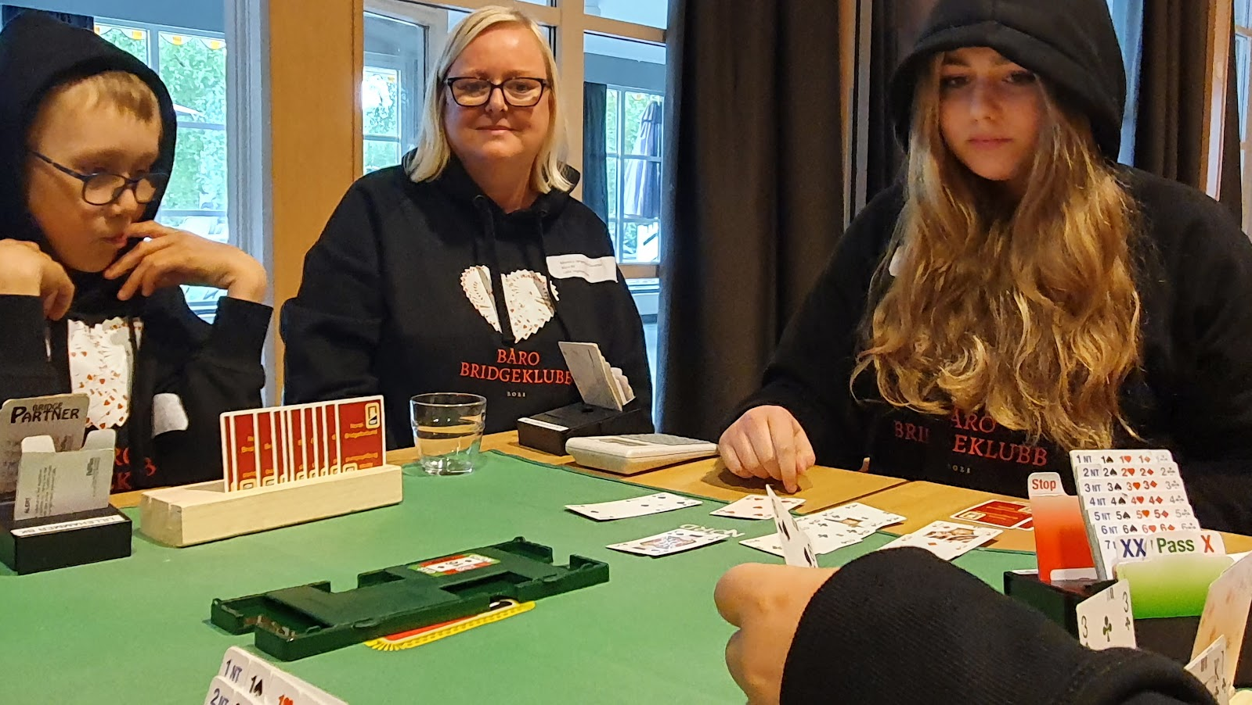
Change perspective: What can bridge offer?
A warm and competitive environment that includes those who don’t have the best physical abilities
An arena for kids to blossom
Two screen-free hours where the kids interact with others, supervised by adults
Skills that will help them do better at school
A reasonably priced leisure activity
Travel
A network that will help them socially when studying, getting their first job, getting through hard stages in life
Notes:
So, if we do change our perspective, to look at what we can offer society, what do we find?

Slide 6
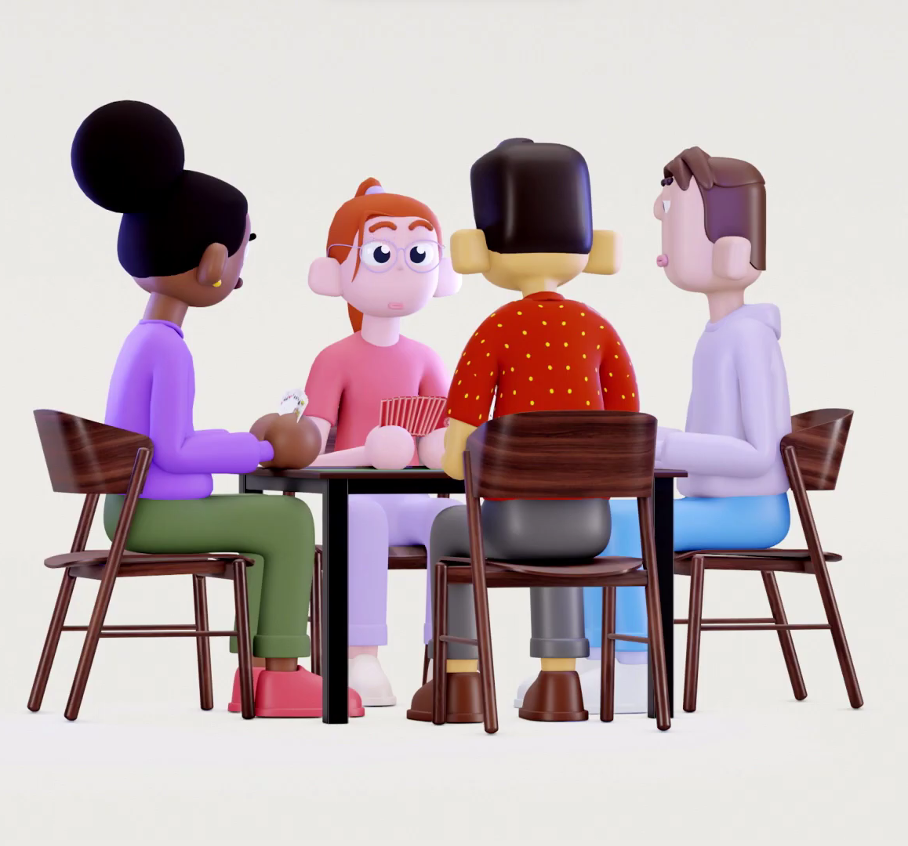
How can we offer this to every kid?
Create a national project
Change our way of teaching bridge to suit kids
Establish after-school bridge for kids, where they meet other kids, not just their grandparents
Access schools to introduce bridge to kids
Get funding to offer this for free
Notes:
So how can we do something, for society, by offering this to a wider audience? We had to make it a national project. And based on our experiences that kids have NO previous experience, we’d have to change our teaching material to suit kids.
Since being a part of the school system is a too Big Hairy Audacious Goal, we aim for collaborating with the schools offering an after school activity as a prolongation of the school day. We also need a method to access the kids to show them bridge, in which the school time where we meet all kids is ideal.
Finally, we’d like funding, to offer this for free.

Slide 7
The process for Norwegian School Bridge
Formulated a national project
Applied for funding
Started March 2023
Notes:
After changing our perspective, the process for Norwegian School Bridge was: formulating a national project, applied for funding, and…. We got the money, first try! Thanks to Sparebankstiftelsen DNB.

Slide 8
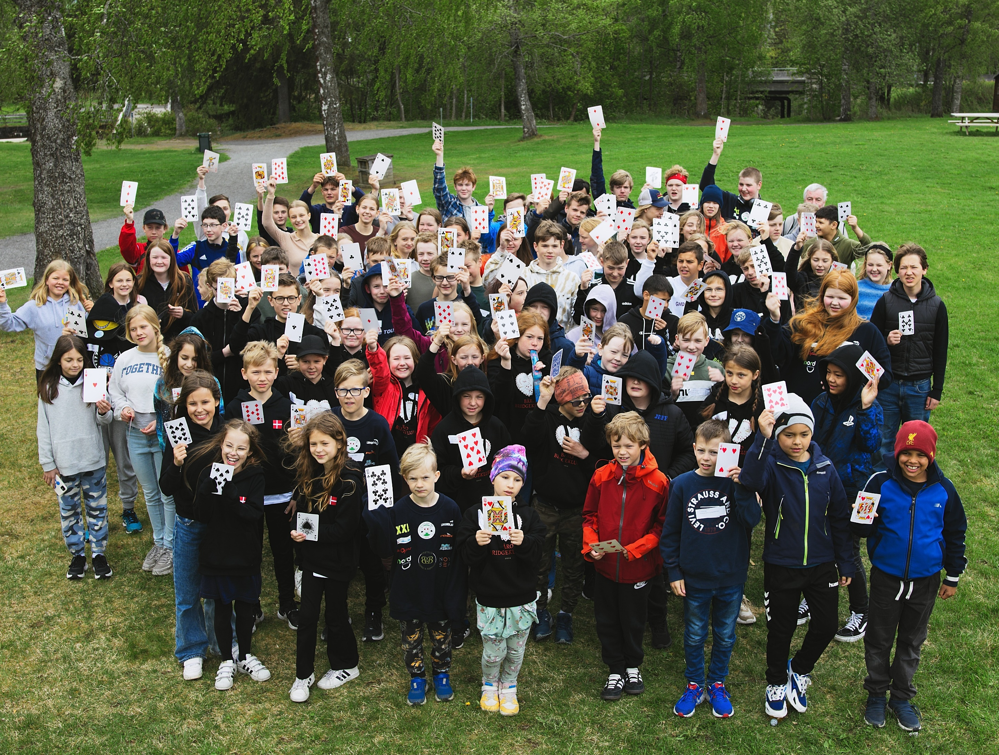
Short time goal: Bridge intro to 10 000 kids
Introduce 10 000 6th graders to bridge within 3 years
Establish after-school bridge at 15 schools in 2023, and another 10 schools in 2024.
Running numbers: 498 kids, 103 has joined the leisure activity
We believe this is doable in many countries. We’ll show you what we have identified as the key success factors.
Notes:
We are currently running a project where we will introduce 10 000 6th graders to bridge, and establish an after school activity with bridge at 15 schools in 2023 and another 10 schools in 2024
The key factor to do this, is to gain access to schools. There are some differences in what kids learn at school in Norway, Poland, France and the US, but there must for sure be many similarities too! Bridge is an excellent tool for teaching many parts of the curriculum: social skills, algoritmic thinking, statistics etc. In Norway the teachers have the freedom to choose their method for teaching, and thus may choose to include bridge as a method. Not as a subject, but as a method for learning other skills.

Slide 9
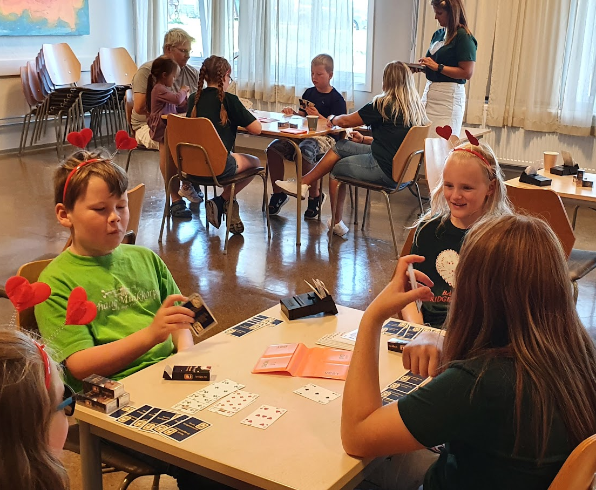
Bridge in schools: Overall goal
Establish Norwegian School bridge as a partner organization with the Norwegian school system.
Bridge remains an activity for future generations to enjoy.
The kids are offered an activity where everyone is included, that gives them a network and skills to help them later in life.
Notes:
As organizations or bridge teachers, we have to change our attitude: We dont ask for a lot when we ask for 2 hours to introduce bridge to kids during school hours. This is, in fact, our gift to the school and to future generations. It is also a contribution to society that we maintain the generous bridge environment that includes everyone.
The project period is 2 years. But we have not started this to stop in 2025. We hope to succeed in a way that makes Norwegian School bridge an important and long lasting agent in the school system. We all know that bridge is a fantastic game offering limitless challenges, possibilities for self-development, a vast network of friends all over the city/country/world. It’s challenging to learn bridge, but every hour put down is rewarded later on in life.
Bridge awakes all feelings: feer, joy, suspention, despair, anger, loneliness, eagerness, courage, happiness. If you know a bridgeplayer, you’ve probably seen their best and worst sides, and thus have the basis to make friends for life. As a group we’re foregiving and generous: If you know how to play, you’re welcome even if you dont master other aspects of life. The bridge club has an important role in society.

Slide 10
Three steps
1. Finding volunteers. Training of volunteers.
Contact school.
2. At School.
ALL pupils get bridge intro.
During school hours (2h).
3. After-school bridge. Established immediately after visit to school
Notes:
These are the three easy steps we follow. We contact the school and say, hey, we have this offer for you. You are chosen to get a chance to be a part of Norwegian School Bridge project. Only 25 schools nationally get this chance. Then we tell how bridge fits the curriculum, and what the school and the kids get (an introduction, we establish after-school bridge for kids, food, bridge equipment – it’s all free for the school and the parents etc.)

Slide 11
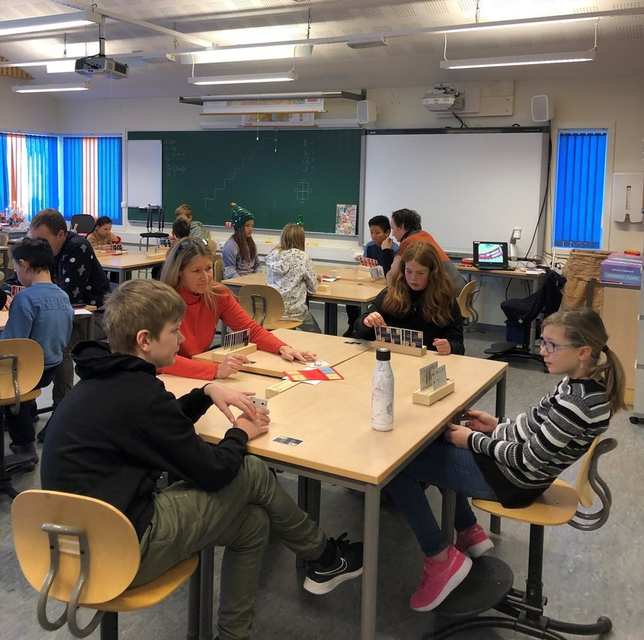
School visit: The
goal is motivation
We only ask for 2 hours
Absolutely necessary to catch their interest
GOAL: Love of the game! The kids should feel they’re mastering the basis of trick-taking games.
Be motivated to join the bridge group to learn more.
Notes:
We’re careful not to ask too much: Two hours for an introduction class, mandatory for all pupils in the class, is enough to give the kids a feel of the game.
It is absolutely necessary to get these two hours to catch their interest, because no one will attend to an activity of something gibberish they have never heard of.

Slide 12
Effects of changing perspective
From: «What can new members offer us» to «what can we as a bridge club offer society»
Message better received: Bridge seems more attractive to new members
Society accepts bridge in a new way
Working with club culture comes easier
Also a lot easier to get funding
Notes:
A few years ago we used to think: How can we get kids to play bridge? How can we encourage parents to bring the kids to youth camps. When we changed our perspective to: These are the skills and activities we offer your child, it will be rewarding and fun both in a short and long term perspective, the message was much better received.
When we talk about all the benefits of bridge – local and global network, better social skills, problem solving skills, training math, travel, new friends, studies indicates the delay of dementia, then society sees and accepts bridge in a new way.
And, also, A LOT easier to get funding.

Slide 13
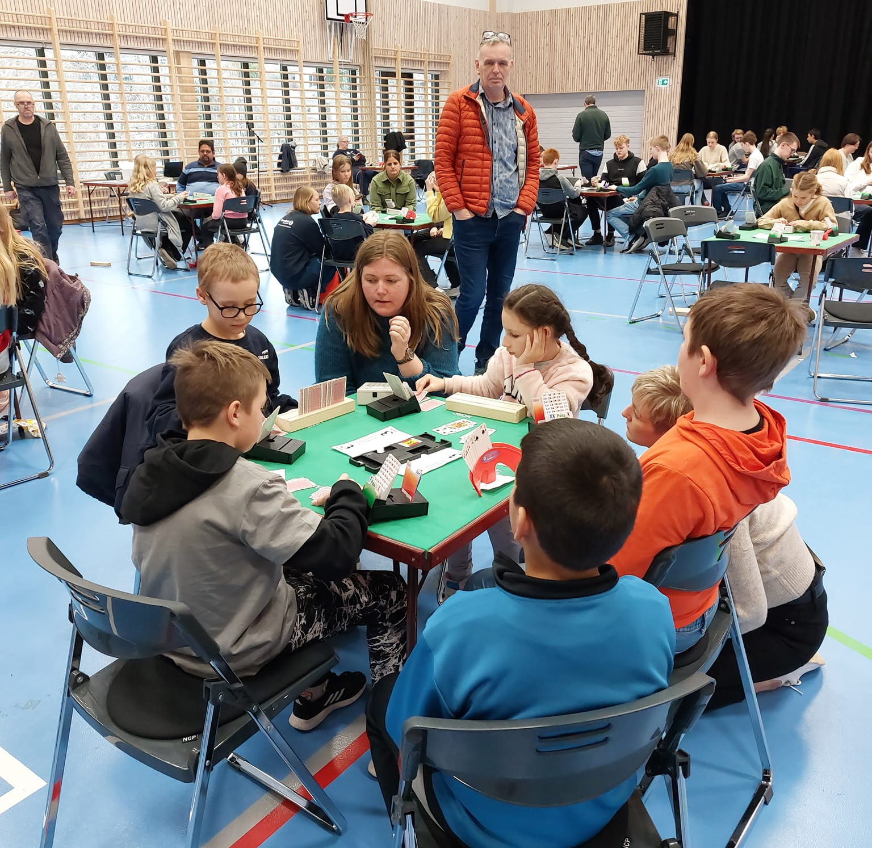
Long time perspective – involve parents
Parents are a golden resource!
Work actively to include parents of kids who joined the bridge group
Establish a method of communication that works for you
Bridge is an activity that may be exercised across generations
Maybe you see the parents before the kids in your local club?
Notes:
In this picture you see…

Slide 14
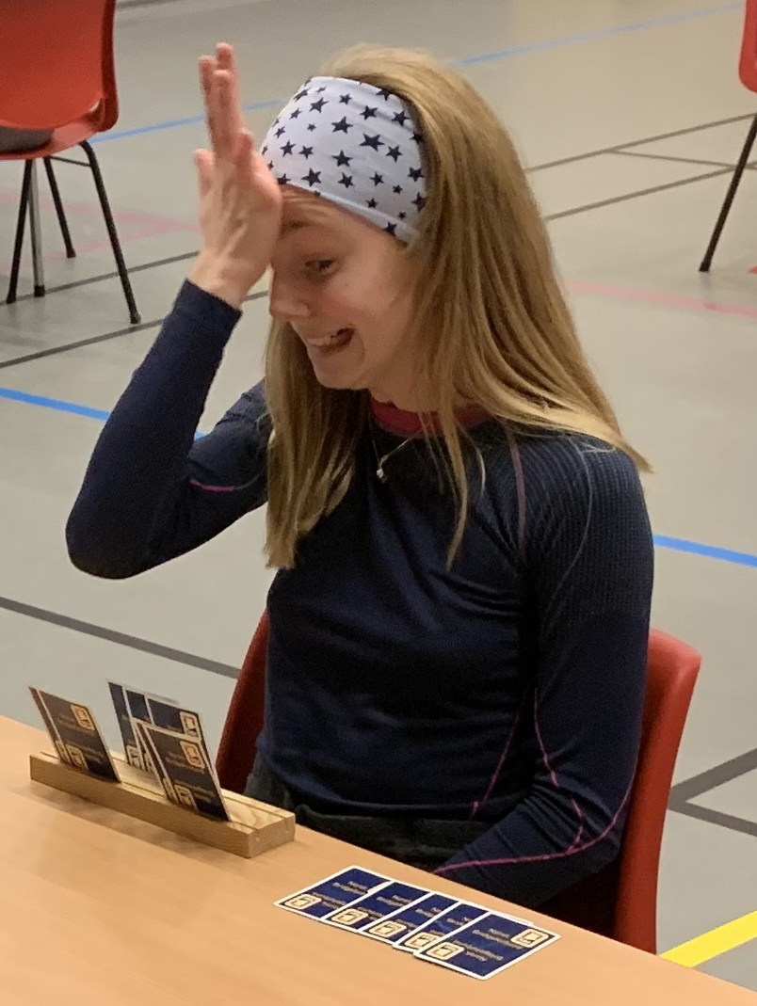
Teaching kids vs adults
Adults have more experience, more basic knowledge.
Adults chose to learn bridge because they like to play cards. Kids might be motivated by other factors (their friend attended, want to impress a grandparent, love food, curious, bored)
Adults are normally more motivated than kids, and thus learn faster.
Kids have no previous experience in trick taking games. We start TOTALLY from scratch.
Adults have more self control, and are able to regulate their feelings to a higher degree.
Even “easy things” such as sorting their cards, the name of the suits and the honours, ranking of the cards: All new to kids
Kids need room for exploration and play
Foto: Kurt-Ove Thomassen
Notes:
We will get a very varied group of kids. We’ll embrace that. Look around the bridgeclub – will you ever find a more diverce group?
Kids start their learning journey at a different stage than an adult. They dont know the name of the suits or the ranking ot the cards. We have to accept that. We have to start where the child is, and realize that we have to learn one thing at a time, and we start practicing the name of the suits.
Adults have the ability to regulate their feelings. If a kid is bored, happy or angry you will NOT miss it!

Slide 15
First day of after-school bridge
Time: prolongation of school day
How many will show up? How do we prepare?
What is important to make the kids feel seen, safe, welcome and included?
Motivate to repetition: What do we do to make them return?
Establish contact with parents
Notes:
Within a week of the school bridge intro, we establish the after school bridge. We have a lot of retired members. We might see that as a weekness of the organization, but healthy youngish newly retired people are a huge resource, and it also offers possibilities to arrange after school bridge for kids mid day.

Slide 16
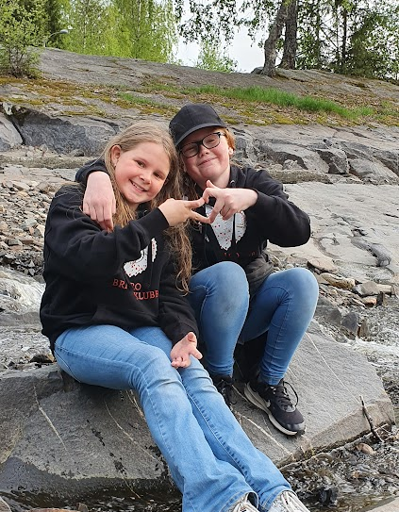
Motivations
What motivates kids isn’t necesarily the same thing as motivates adults.
It is rarely only the game itself
Food, drinks, travel
Being part of the group
Excitement, play, exploration
Interacting with others
Their motivation may change as they learn more
Notes:
We have to talk about motivations, and how motivations may change.

Slide 17
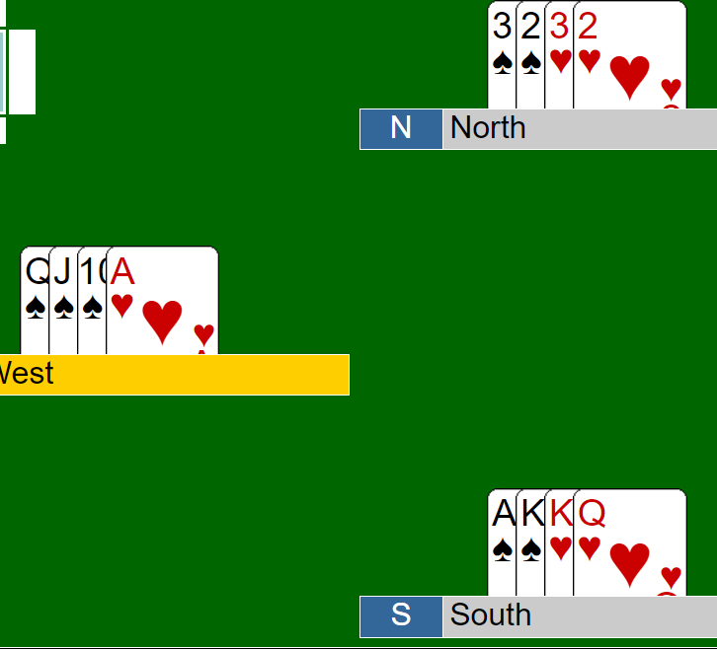
Balance progress vs comfortable learning pace
A kid with high learning potential, will pick it up and do it when you say «Lead top of sequence»
Everyone else will have to practice, multiple times.
Break down the problems
Quicker, everyone gets to practice the same problem. Repetition!
Possible to differentiate without any of the kids noticing
Notes:
We need to include kids with all kinds of motivations in the learning journey.
When you explain what a sequence is, and why we lead the top card to communicate and collaborate better with partner, the kids with high learning potential will catch this relatively fast.
This does not mean that you may move on to the next theme! Then you will loose 90 % of the group. Because everyone else will have to practice multiple times – maybe for months. And they wont even spot the problem, when they see 13 or, god forbid, 26 cards, and you might not spot that they have not spotted the problem... To include everyone, it is important to break down the problems. And that is where we have to do some ground breaking.

Slide 18
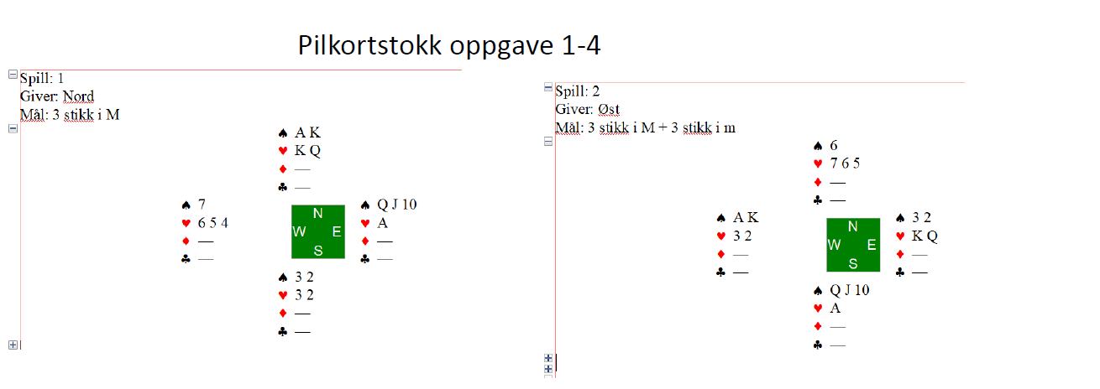
How to differentiate to include everyone
Notes:
Look at this problem: East leads top of sequence (we talked about this, this is not easy). North’s task is to win 3 tricks. This is hard, and has to be practiced multiple time by every child.
This is an example of how we make repetitions and differentiate. We use only four cards each to break down the problem. Leader leads top of sequence, and declarer’s task is to win 3 tricks. You may make multiple variations of this problems to suit the child’s level of play – where it’s easiest to spot the solution when having all honour cards in one hand, and when you split the hounour cards between dummy and declarer it becomes harder (without the kids noticing).

Slide 19
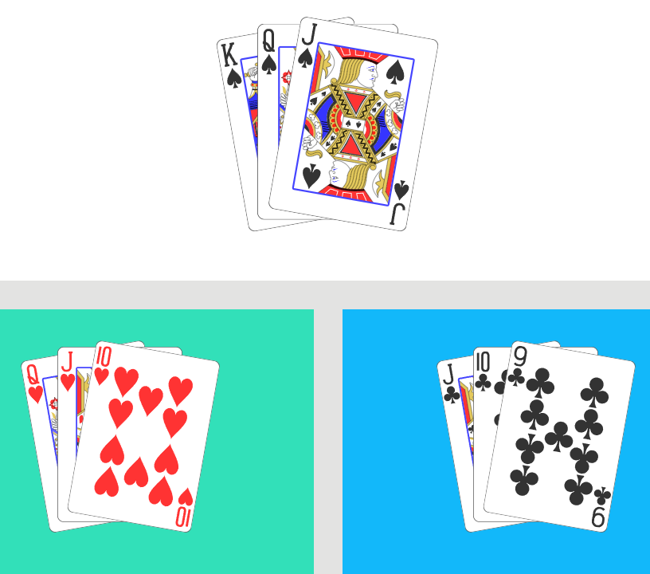
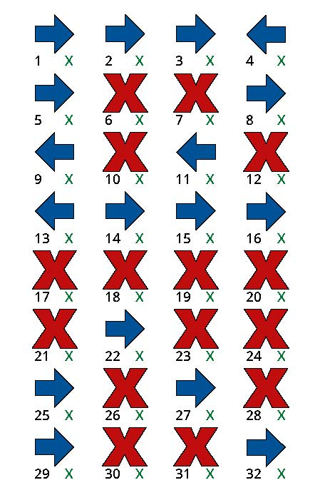
Tools for breaking down problems
Notes:
We are stribing to develop tools for the bridge teacher to break down the problems. Thus we make sure every kid is included in the learning journey. Especially for the kids who need extra time to learn new skills, this is very important.

Slide 20
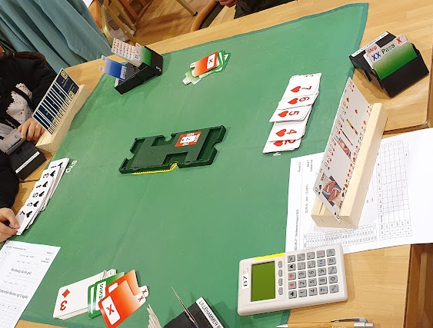
Factors for long lasting activity
Safety. The kids must feel seen and welcome.
Predictable. The kids must know what is going to happen.
Good environment, socially.
«Carrots», literally and figuratively.
Look forward, allow play. Talk about what we’re going to do in weeks to come.
Allow the kids to explore
Notes:
Raise your hand, if you want to rip your hair off by this bidding sequence… But by talking about it afterwards, we might learn more than by interferring with the auction. Allow exploration and play. So if you look at this bidding sequence, we learn that we should cooperate as a partnership. You will fail if you keep insisting on your suit. We learn to adjust to others. No man is an island! And as opponents, we learn to critically assess information given by others. Will they really make 6 hearts? We learn fair play – to gracefully accept a loss or a win.
It has to be fun, it has to be fair. The kids must feel seen and welcome.

Slide 21
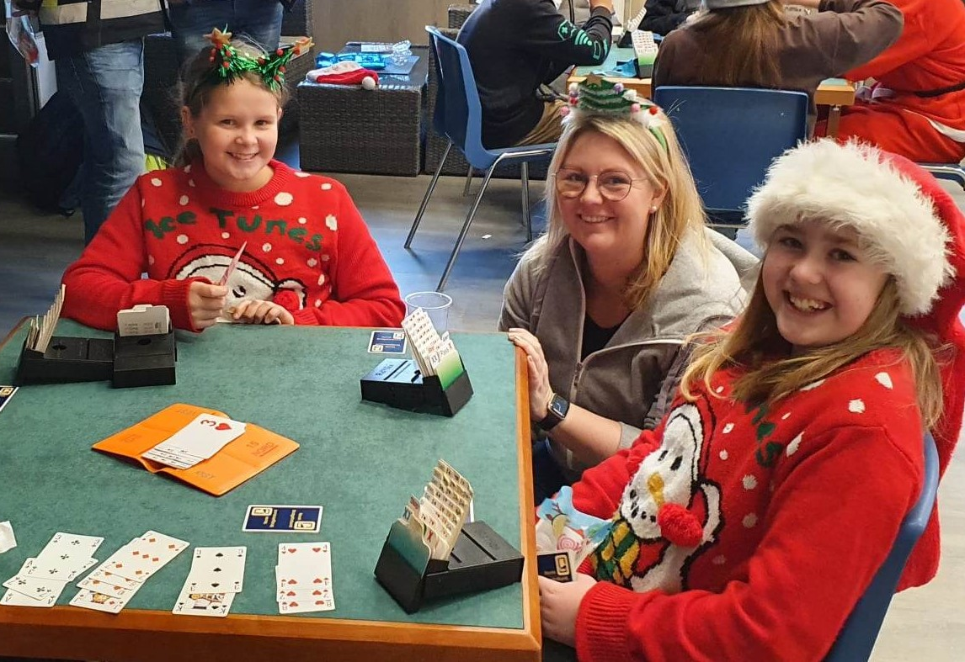
The importance of including all kids
No matter what their motivation is (it might be the food, loneliness, being with friends or the game itself), we need to see, accept and include all kids.
They will learn at different paces, you don’t know who will come to love the game of bridge for life
The group dynamic depends on us treating every kid in a respectful way
What happens if we don’t? The one who came for the food quits. The one who loved the game quits, because she came to be with the foodie. The lonely one quits when the others aren’t attending bridge.
Also, we have to succeed on this point for parents and school to embrace us

Slide 22
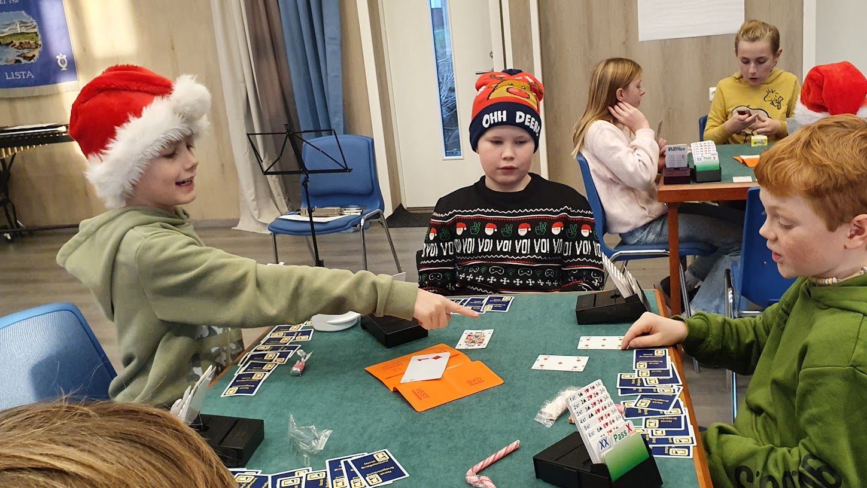
Rule nr. 1 in bridge
Notes:
In our group of kids, one of my helpers wanted to tell the kids a story. About how he forgot to follow rule number one in bridge (to him rule nr. 1 was to take tricks). He started to tell the story, and asked the kids: Do you know what rule number one in bridge is? ALL hands in the air. A couple of them reached their hand so high it almost came loose from the shoulder. He asked one girl who was about to burst to tell the answer. A sigh of relief from her, and «To have fun!» All kids sighed of relief and nodded.

Slide 23
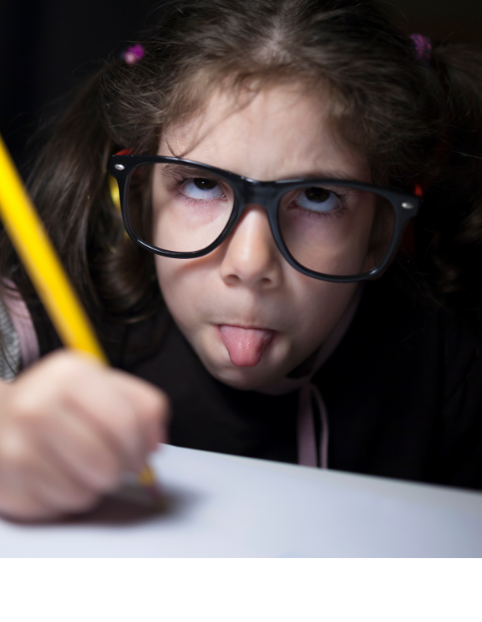
Recipe to copy this:
Do your homework!
Change perspective to «What can bridge offer the kids, school and parents?»
  Inclusive activity, independent of physical abilities, mental stage, economy, race, age
  Train problem solving skills in cooperation with others, drawing positive and negative inferences, algorithmic thinking
  Have to cooperate; train social skills, fair play,
Read the curriculum thoroughly!
  Find the exact parts where bridge fits. Make a document.
Get funding!
  Foundations, heritage, members, governement, EU
Notes:
The project we’re running is quite unique, I believe, but it is doable in many countries,

Slide 24
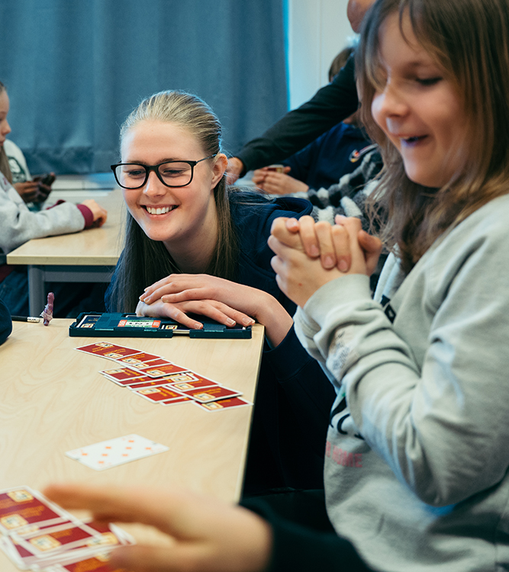
Funding
What do you want to do? Make a rough plan of your project.
Sparebankstiftelsen DNB. Could have been any other of these:
  Gjensidigestiftelsen
  Olav Thon stiftelsen
  OBOS stiftelsen
  SR bank
Do you have such foundations in your country? I was only recently aware of them and the opportunities.
Erasmus+
Foto: Stig B. Fiksdal
Notes:
This is the first time we applied for such a project. It was instantly approved. Bridge tick on every criteria: Inclusiveness, for all, mental health, education, prevent economic alienation, etc.

Slide 25
Change of perspective
The change of perspective allowed us to:
Get funding for a unique project
Find new volunteers
Get acceptance from schools, parents and society
Run a sustainable after-school activity with bridge for kids

